Slide 1


CPS 109 Lab 3
Gurpreet Kaur
Mojan Nooshin

Slide 2


Lab 3: Agenda
Quiz 2 Discussion
Lists
Loops
Lists with Loops Examples
Quiz 3

Slide 3
Loops
Used to execute a group of statements a certain number of times.
Types
For
While
Nested Loops

Slide 4
For loop
For loops can iterate over a sequence of iterable objects in Python.
Iterable objects could be strings , lists , tuples , sets and dictionaries

Slide 5
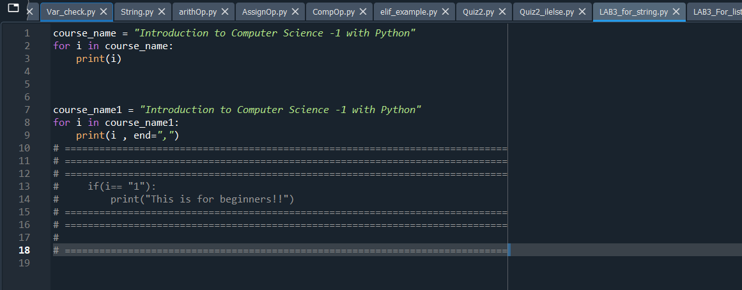
Iterating over string

Slide 6
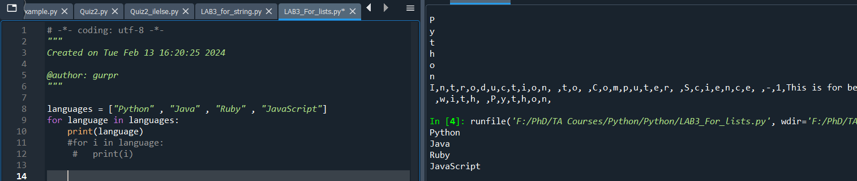
Iterating Lists

Slide 7

Range():
What if ?
We don’t want to iterate over a sequence ?
We want to use for loop for specific number of times ?

Slide 8
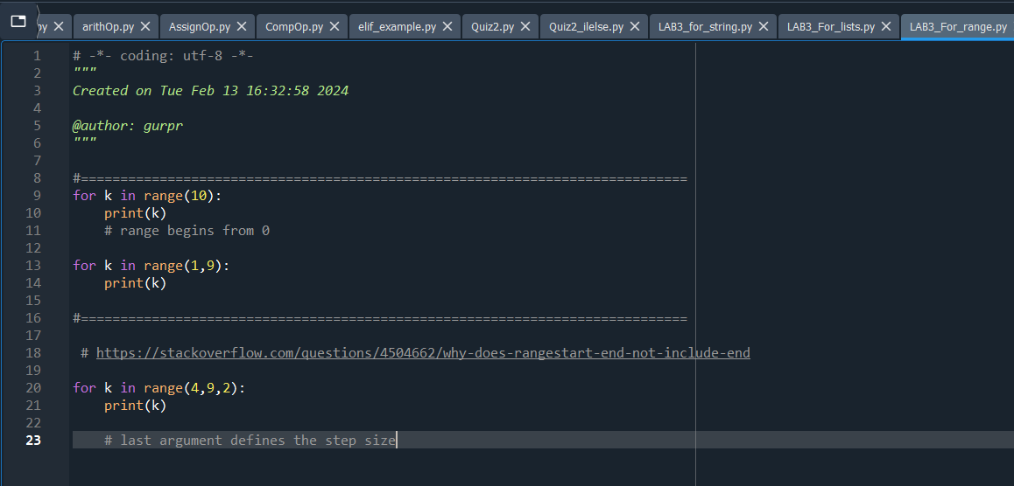
Example

Slide 9
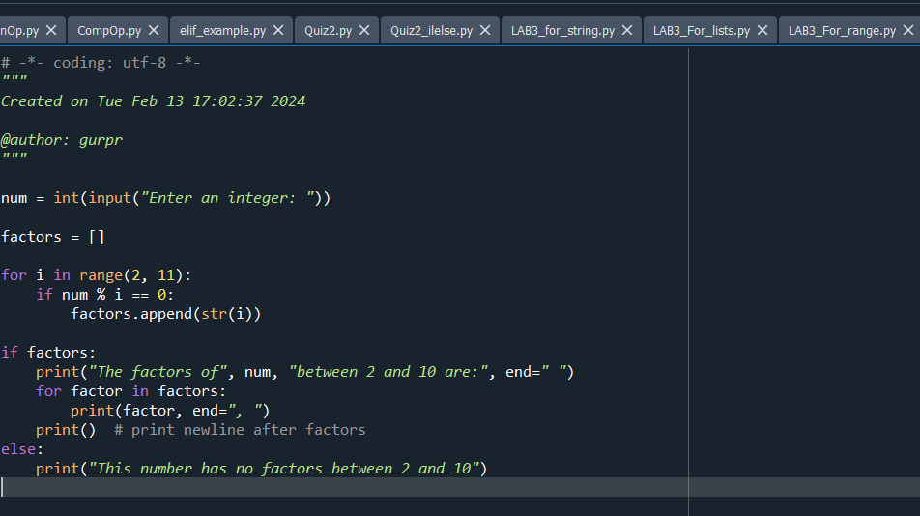
Quiz 2 Question

Slide 10
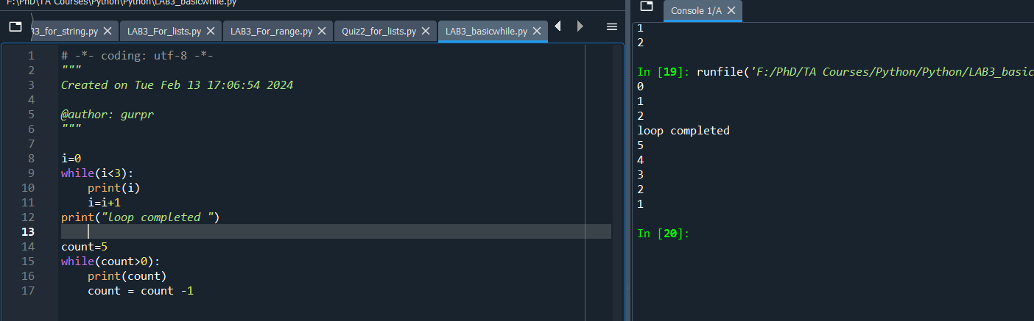
While loop

Slide 11
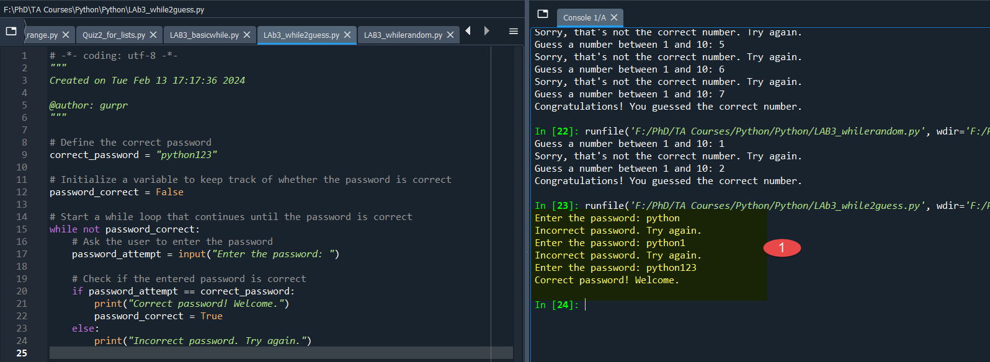
Examples: While2guess.py

Slide 12
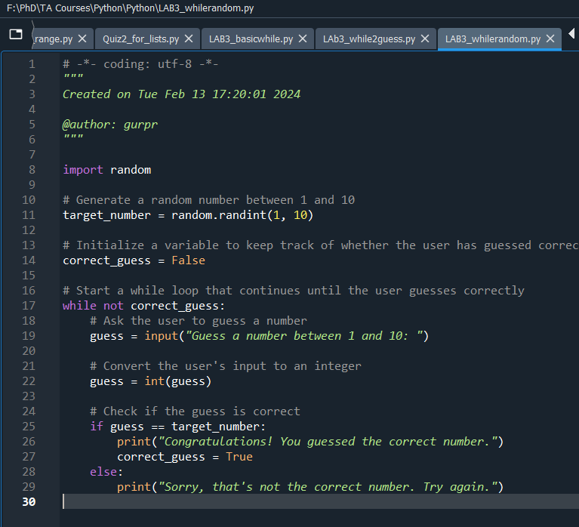
Examples: Whilerandom.py

Slide 13
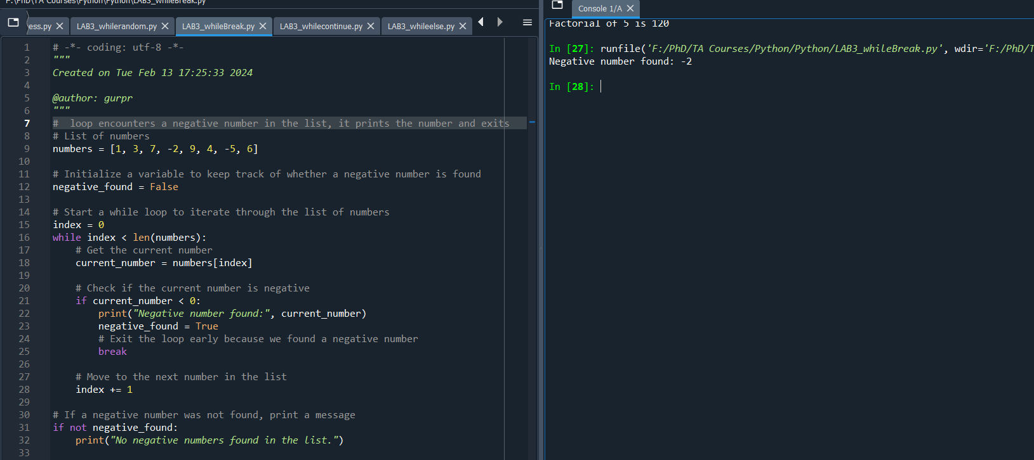
Break : whileBreak.py

Slide 14
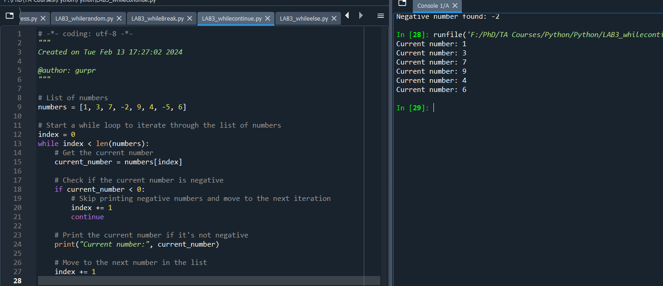
Continue: whilecontinue.py

Slide 15
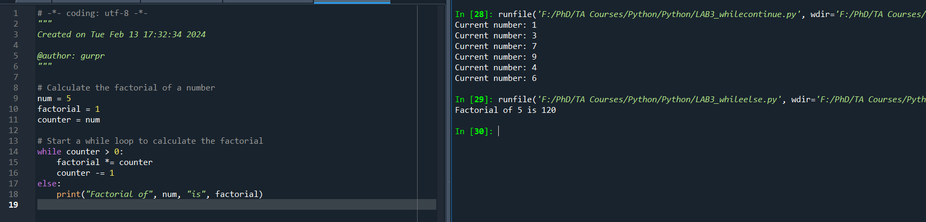
Example: Whileelse.py

Slide 16
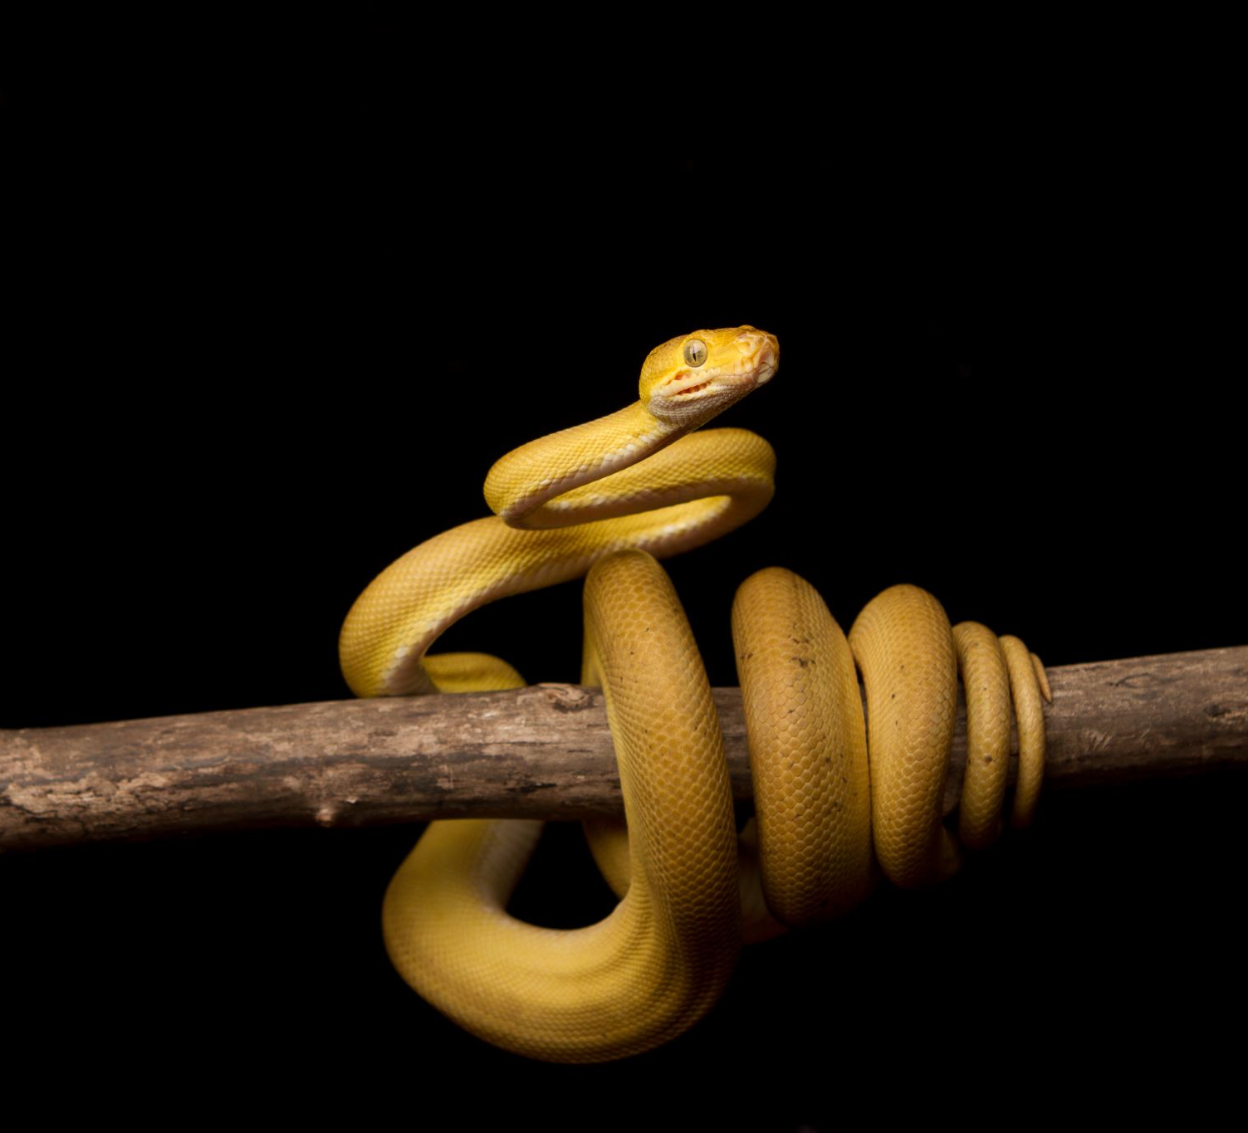
Note:
Do While loop does not exist in Python but works with Java/C/C++

Slide 17


Thanks !!
Presented by : Gurpreet and Mojan
Quiz Time!!

Slide 18
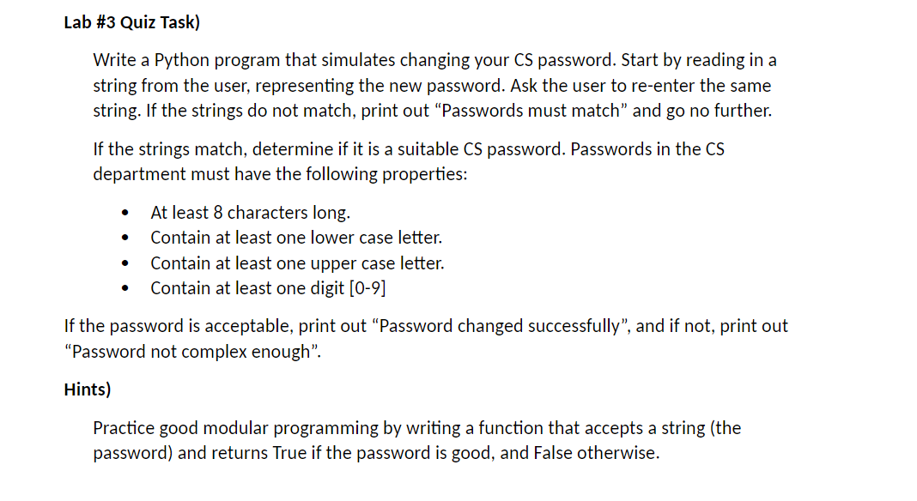
Quiz

